Slide 1
Chapter 13 Resistance-Training Concepts
Notes:
1

Slide 2
Learning Outcomes
Goals:
Explain general adaptation syndrome
Explain principle of specificity and adaptation
Explain stability, muscular endurance, hypertrophy, strength, and power.
Notes:
2

Slide 3
Basics
The last part of the workout template
Commonly known as most important part of workout program
Strength and flexibility assessments are required for optimal program design
Skipping assessments can end up causing more harm than good
Notes:
3

Slide 4
Adaptation
How it helps
Better cardiovascular fitness
Looks, health (feeling better), and performance (in sport or other activities)
More muscle mass
Less body fat
Better metabolic efficiency
Better tissue tensile strength
More bone density
Improve endocrine and serum lipid adaptations
Notes:
4

Slide 5
General Adaptation Syndrome
The body wants to maintain balance (homeostasis).
Phase | Action
Alarm Reaction | First reaction to stress
Resistance Training | Adapting to stressors
Exhaustion | Extended stressor leading to fatigue
Notes:
5

Slide 6
The Principle of Adaptation
Specific Adaptation to Imposed Demands (SAID Principle)
The body adapts to specific demands placed on it
Notes:
6

Slide 7
Overload Rule
Rule that states the must be a stressor that is stronger than current ability of one's body to influence positive adaptations. *
Notes:
7

Slide 8
Specificity Rules
Mechanical specificity is the weight and movements placed on the body .
Endurance is developed through low weight and high repititions
Strength is developed through high weight and low repetitions
Neuromuscular specificity is the speed of contraction and exercise selection

Slide 9
Specificity Rules
Metabolic specificity: Energy demand placed on the body
Long periods of exercise with minimal rest will help develop endurance
Endurance training uses aerobic pathways
Max strength requires longer rest between sets done with heavier loads (higher intensity)
Anaerobic pathways are used during max strength training

Slide 10
General Adaptation Syndrome
The general adaptation syndrome (GAS): Refers to how the body reacts to stress. Stress from resistance training for our purposes.
GAS helps explain reasoning behind periodization
3-6 weeks is the best time to participate in a specific workout routine.
Going beyond this time will result in slower gains, plateauing, and higher risk of injury.
Three stages of response to stress:
Alarm reaction
Resistance development
Exhaustion

Slide 11
Alarm Reaction Stage
Alarm reaction
Triggers physiological and psychological stress responses
1-2 weeks
Resistance Training Alarm reaction
increased oxygen uptake
Increased blood supply throughout the body
Increased neural recruitment to muscles

Slide 12
Resistance Development Stage
The body increases its ability to adapt to stress
3-6 weeks
We get better at recruiting muscles as well as delivering oxygen and blood to muscles

Slide 13
Exhaustion Stage
Lon periods of stress or too much stress leads to the body breaking down and increases risk for injury
Possible problems
Stress fractures
Muscle strains
Joint pain
Emotional fatigue
More than 6 weeks will put you at risk for entering the exhaustion stage.

Slide 14
Progressive Strength Adaptations
Strength
Capacity of the bodies neuromuscular system to create tension within the muscles to react to and overcome and external force
Notes:
14

Slide 15
Strength Adaptations
Five main categories
Stabilization
Muscular Endurance
Muscular Hypertrophy
Strength
Power
Specific progressive sequence
Notes:
15

Slide 16
Stabilization
- - Required when training for adaptations to ensure one has enough postural stability to handle the amount of stress needed to progress.
-- Know progressions for stabilization can be important too. For instance when doing the two arm ball chest press, which is the stabilization exercise* shown below, a progression can be to alternate arms.*
Notes:
16

Slide 17
Muscular Endurance
Maintaining force for prolonged periods of time
Strengthens core and joint stabilization
High repetition resistance training is best for endurance gains
Muscular endurance is a goal of the Stabilization Phase*
Notes:
17

Slide 18
Hypertrophy
Growing skeletal muscle fibers through manipulation of reps and rest
Tells clients why they should start and revisit the stabilization period of training before going into the strength period
Notes:
18

Slide 19
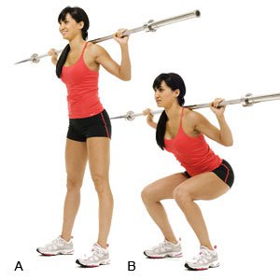
Strength
Gives fundamental development from stabilization training to raise levels of stress placed on the body.
Provides ability for new adaptations to be occur
More weight and volume are beneficial for influencing the recruitment, synchronization, and firing rate of motor units
Also places requisite mechanical stress on the muscles to promote size and strength.
Notes:
19

Slide 20
Power
Capacity to generate the most possible force in the shortest period of time
Development of force and/or velocity leads to escalation of power
Notes:
20

Slide 21
Resistance Training Programs
Single-Set
Multiple-Set
Pyramid
Superset
Circuit-Training
Peripheral Heart Action
Split-Routine
Vertical and Horizontal Loading
Notes:
21

Slide 22
Single-Set Program
One set of each exercise
Good for new, deconditioned clients*
Influences adequate adaptive responses for connective tissue and nervous system before participating in more vigorous training
Just as effective as multiple-set system for beginner clients
Notes:
22

Slide 23
Multi-set Program
Multiple sets of each exercise
Advanced clients
Better than single-set for clients with higher levels of fitness
Notes:
23

Slide 24
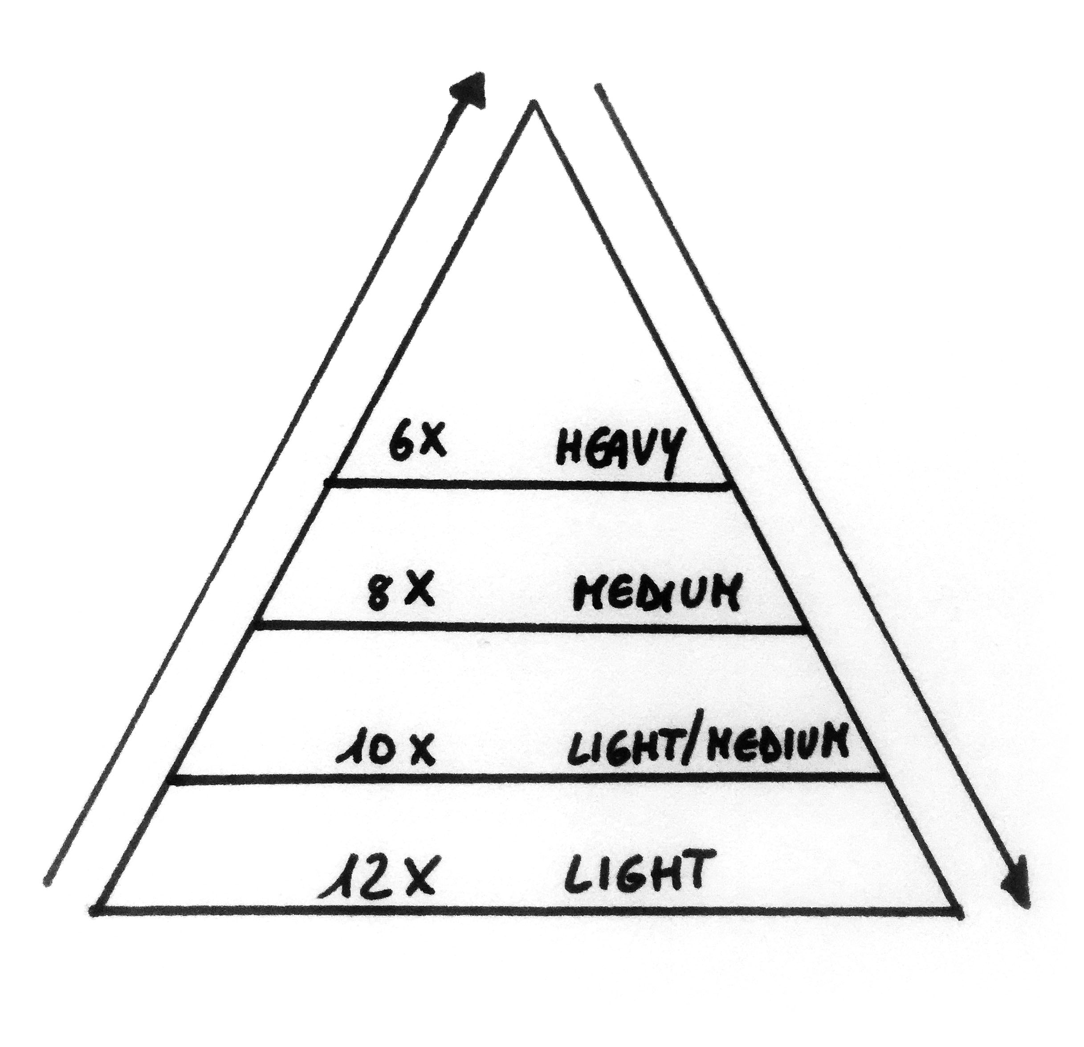
Pyramid System Program
Notes:
24

Slide 25
Superset Program
When two exercises are performed back to back without rest in between them
Tri-Set System
Three exercises performed in rapid succession
Giant-Set System
More than three exercises in rapid succession
Notes:
25

Slide 26
Drop-set Program
Working a set to failure
After failure you remove a small percentage of the load (5–20%) and continuing with the set for a small number of repetitions.
Use with more advanced lifters
Notes:
26

Slide 27
Circuit-Training Program
Multiple exercises done in succession with minimal rest
Best for people with limited time and body composition goals
Notes:
27

Slide 28
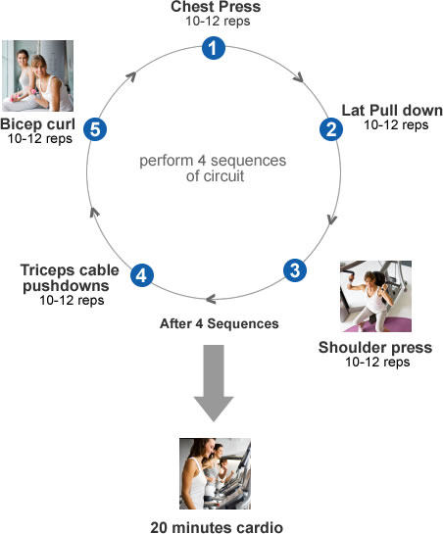
Circuit-Training Program
Notes:
28

Slide 29
Peripheral Heart Action Program
Type of circuit training
Switches between upper and lower body exercises
Equal blood flow between upper and lower extremities
PHAS is great for clients over 55* or any special populations client and for altering body composition
Notes:
29

Slide 30
Peripheral Heart Action Program
It is important to note that in designing PHAS strength circuits, be sure to include strength exercises which are typically done in a seated position on a stable surface.*
Stabilization | Strength | Power
Stability ball squat | Barbell squat | Squat Jump
Stability ball DB chest Press | DB Incline Chest Press | Lateral Med Ball Toss
Single leg DB curl to press | Lat Pull downs | Med ball chest pass
Single leg squat touch | Seated Barbell Shoulder Press | Overhead med ball pass
Notes:
30

Slide 31
Vertical Loading Program
Complete exercises for each body part before beginning next set.
Muscle Group | Sets | Reps
Chest | 3 | 5
Back | 3 | 5
Arms | 3 | 10
Shoulders | 3 | 10
Legs | 3 | 10
Notes:
31

Slide 32
Horizontal Loading Program
Perform all sets of an exercise or body part before moving on to the next exercise or body part.*
Notes:
32

Slide 33
Split-Routine Program
Working a different body part/muscle group each day
Allows for more work/volume for that muscle group during a single session
Notes:
33

Slide 34
Split-Routine Program
Days per week | Days Exercise is done on | Muscle Groups Trained
2-day | Tuesday Friday | Chest, back, arms Legs and shoulders
3-day | Tuesday Thursday Saturday | Chest and arms Legs Back and Shoulders
4-day | Monday and Thursday Tuesday and Friday | Chest, back, arms Legs and shoulders
Notes:
34

Slide 35
Summary
The OPT™ method follows a progressive, systematic approach that enables the fitness professional to make consistent gains with all clients through training manipulations to achieve various goals.
It is critical to develop appropriate stabilization before performing exercises with heavy load (strength) or high velocity (power).
There are many training systems that can be used to structure a resistance-training program for different effects including single-set, multiple-set, pyramid system, circuit training, peripheral heart action, split-routine, vertical loading, and horizontal loading.
Notes:
35

