Slide 1
Chapter 5 Human Movement Science

Slide 2
Learning Outcomes
Expectations:
Explain biomechanical vocabulary, frontal, sagittal, and transverse plains of motion and how the body moves through these planes
Forces acting on the human body and it's response
Motor behavior/Motor Learning
Sensory informations role in movement

Slide 3
What Does the Human Movement System Do?
The Human Movement System's responsibilities:
Know where it is in space with the external and internal environments
Constantly collecting information
Tell the body what is the right movement to do

Slide 4
Biomechanics
Combining physics with how the body moves
Vocabulary
Knowing anatomy and physiology terms
Allows for effective communication

Slide 5
Anatomic Vocabulary
Superior is a point above a given reference point
Inferior is a point below a given reference point
Proximal a point nearest the midline of the body or point of reference
Distal a point furthest from midline of body or point of reference
Anterior a point on the front side of the annatomocial body

Slide 6
Anatomic Vocabulary
Posterior a point on the backside of the body
Medial a point closer to the midline of the body
Lateral a point relatively farther away from the midline of the body or to the outside of the body
Contralateral a point on the opposite side of the body from the reference point
Ipsilateral a point on the same side of the body from the reference point

Slide 7
Moving Through Space
Three imaginary planes are positioned through the body at right angles
Movement can occur in one plane of motion or multiple planes of motion depending on the complexity of the movement
Movement in a plane occurs about an axis running perpendicular to that plane.
Anatomic position, is reference position

Slide 8
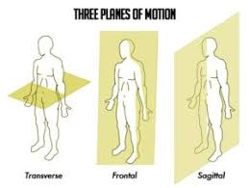
Moving the Body
Sagittal plane Cuts the body into left and right halves and deals with most flexion and extension type movements
Frontal plane cuts the body into from and back halves and deals the most adduction and abduction
Transverse plane cuts the body into top and bottom halves and deals with rotational movements
Use the book to study all joint motions.

Slide 9
Moving the Body
Horizontal abduction- moving and arm or leg in the transverse plane from an anterior to lateral position
Horizontal adduction- moving an arm or leg in the transverse plane from a lateral position to an anterior position.

Slide 10
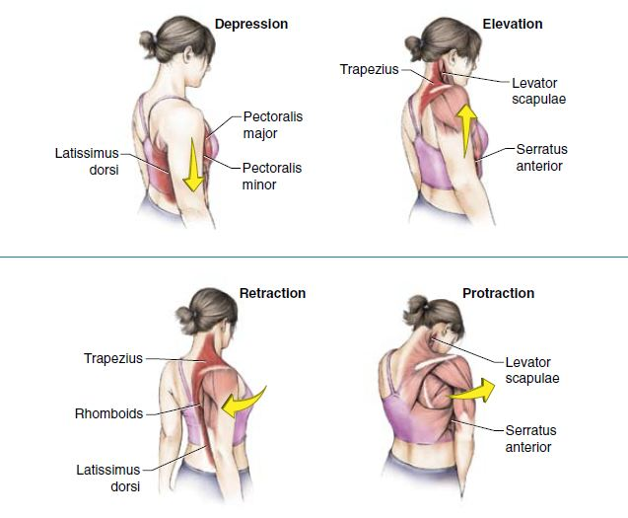
Back Movements
Scapular retraction- Bringing the shoulder blades closer together as if you are trying to squeeze something between them
Scapular protraction- Moving the shoulder blades further away from each other
Scapular depression- When shoulder blades move downward
Scapular elevation- when shoulder blades move upward towards ears

Slide 11
Muscle Movements
Eccentric
Muscles get longer
Force reduction
Ex. Gluteus Maximus eccentrically flexes the hip
Isometric
muscle length does not change
Dynamically stabilize the body
Ex. Gluteus Maximus isometrically stabilizes the hip
Concentric
muscles shorten
Force production
Ex. Gluteus Maximus concentrically extends the hip*

Slide 12
Functional Anatomy—Muscles
Typically we think of muscles moving in one plane of motion and contracting only concentrically
In actuality muscles move in all planes of motion constantly as well as use multiple types of muscle actions to create movement

Slide 13
Force
Speeding up or slowing down of an object due to the interaction between two outside presences is known as a force
Torque is rotational force as a result of muscular forced being applied to a joint*

Slide 14
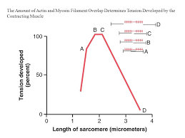
Creating More or Less Force
Point at which a muscle can produce the greatest amount of force
When actin and myosin in the sarcomere have the greatest amount of overlap
Going beyond optimal length reduces force production
Too much shortening of muscles creates too much overlap between the actin and myosin and reduces force output as well
Shortened or tight muscles due to adhesions are known as Altered Length Tension Relationship. Ex. Feet turn out and put the Gluteus Maximus in a position that generates less force.*

Slide 15
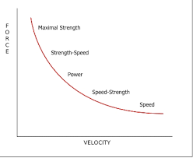
Force–Velocity Curve
Generating more force by increasing velocity
The faster we try to move concentrically the less force we will be able to produce
Slower, eccentric contractions can generate more forece

Slide 16
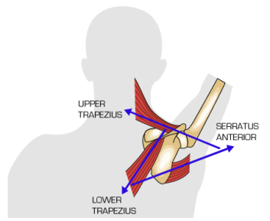
Muscles Working Together
A force-couple relationship: multiple muscles working together to create movement around a joint
Common Force–Couples
Internal and external obliques rotate the trunk.
Upper trapezius and lower portion of the serratus anterior rotate the scapula upward.
Gluteus maximus, quadriceps, gastrocnemius, and soleus produce hip, knee, and ankle extension.
All muscles working together for the production of proper movement are said to be working in proper force–couple relationships.

Slide 17
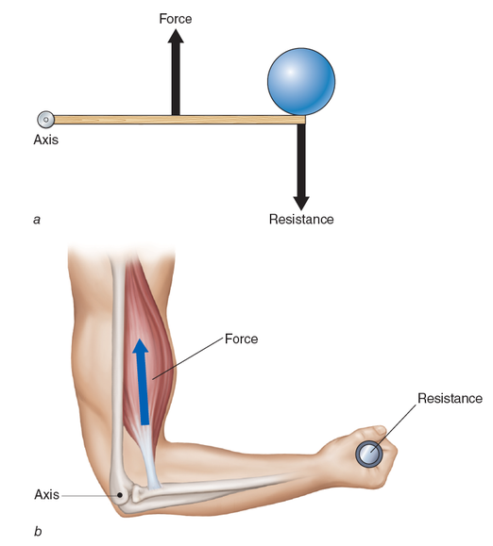
Leverage
Location of the weight in relation to muscles need to produce desired movement determines leverage
A weight closer to the joint is easier to move because it has less torque
A weight further away from the joint has more torque and is harder to move

Slide 18
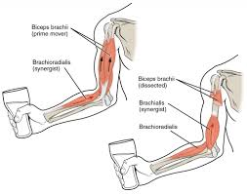
Muscles Working Together
Muscles are recruited by the central nervous system (CNS) as groups or synergies.
When muscles work together to assist prime movers in generating force to produce movement
Squat: Quadriceps, hamstrings, gluteus maximus
Shoulder Press: Deltoid, rotator cuff, trapezius

Slide 19
Proprioception
All signals being sent to the CNS regarding surrounding sensory information about the internal and external environment
CNS receives mechanoreceptor information (muscle, tendon, ligament, and joint receptors) to give feedback about static, transitional, and dynamic position, movement, and sensation in regards to joint movement and muscle force.
Helps the body to move as efficiently as possible

Slide 20
Sensorimotor Integration
The nervous system analyzing sensory information to produce adequate movement
Detection of potential reasons for movement sensory information and the nervous system encourage muscle actions to occur, thus creating a movement
When all sensory information is collected and analyzed an adequate movement will result

Slide 21
Sensorimotor Integration
Has to be good information coming in
We must position our bodies into structural sound positions for efficient movement
This is known as structural efficiency.
When the body is structurally aligned then it well be able to adequately accept forces onto joints and muscles without compromise
This is known as functional efficiency.
poor alignment of joints and muscles results in poor movement and increases risk of injury

Slide 22
Feedback
Promotes permanent movement patterns (good or bad)
Internal
External

Slide 23
Internal Feedback
The information coming back to the central nervous system from all sensory receptors (proprioception).
Also known as sensory feedback
CNS reads incoming sensory information (afferent) and provides the proper response
When a client feels a change in their environment it is considered Internal Feedback.*

Slide 24
External Feedback
feedback given from an external source such as a workout partner, trainer, HR monitor, video, etc
Also known as augmented feedback.
Gives clients another perspective aside from how they are "feeling"

Slide 25
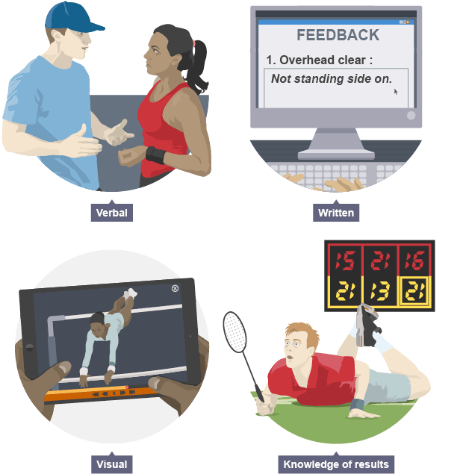
External Feedback
Two major forms
Knowledge of Results
After the client completes a movement the trainer gives them feedback
Knowledge of Performance
Tells them how well or how poor their movement patterns are
Clients need to not depend on external feedback because you want them to be able to self monitor exercise form on their own.

Slide 26
Summary
Each system of the human movement system (HMS) is interdependent.
The entire HMS must work together to gather information from internal and external environments to create and learn movements (motor behavior).
The body uses proprioception, sensorimotor integration, and muscle synergies to create efficient movement (motor control).
Repeated practice, as well as internal and external feedback, allows this efficient movement to be reproduced (motor learning).

